Slide 1
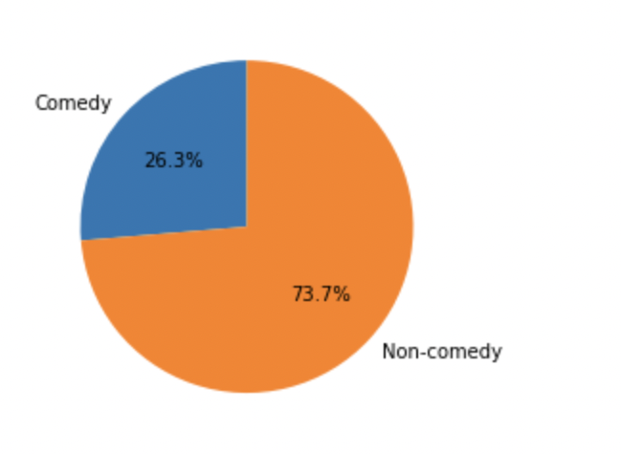
Project Objective:
To develop a predictive model that can predict whether a movie is a Comedy.
Data Description:
movie_story_student_file : contains the movie stories.
movies : This file contain the movie genres.
movie_story_evaluation_file : data to be used after developing and selecting the best model to check if the model predicts the movie as Comedy or not.

Slide 2
Data Preprocessing
Converting to lower case: To make sure that the model doesn't confuse with same words written in different case, we convert all text data to lower case.
Removing Special characters: punctuations do not help in our analysis and hence they are removed.
Removing Stop words: Words that repeat too frequently don’t add value to the model and would confuse it, hence it is good to be removed.

Slide 3
Interpretation of Results
 | Accuracy | Precision | Recall | F1-Score
Logistic Regression | 78.5 | 75 | 28 | 40
Random Forest Classifier | 77.1 | 73 | 21 | 32
MLP Classifier | 72.4 | 44 | 37 | 40
SVC | 75.24 | 57 | 5 | 8
Decision Tree Classifier | 70 | 44 | 41 | 43
*All values are in %. **The above values are for true positive scenario.

